Slide 1
Chiplet Placement for 2.5D IC with Sequence Pair Based Tree and Thermal Consideration
Hong-Wen Chiou, Jia-Hao Jiang, Yu-Teng Chang, Yu-Min Lee, Chi-Wen Pan
National Yang Ming Chiao Tung University, Hsinchu, Taiwan

Slide 2
Outline
Abstract
Introduction
Preliminary
Problem formulation
Chiplet placement with SP-based tree
Post Chiplet placement (post-cp) with thermal consideration
Experimental results

Slide 3
Abstract
This work develops an efficient chiplet placer with thermal consideration for 2.5D ICs
Combine the way of sequence-pair based tree, branchand-bound method, and advanced placement/pruning techniques to find the optimal TWL solution on HPWL fastly
With the post placement procedure, the placer reduces maximum temperatures with slight increase of wirelength
Can reduce 1.035% HPWL, and the placer can speed up at most 2 orders
Can reduce maximum temperature up to 8.214℃ with 5.376% increase of TWL on average
Notes:
這篇paper發明了一個有效率的chiplet placer for 2.5D IC，並且考慮了Thermal的問題
SP-CP (Sequence-pair Chiplet placer):
利用「Sequence-pair based tree」、「Branch and Bound (B&B)」以及「Advanced placement/pruning」的方法，以此快速的找到placing solution 以及找到optimal 的Total wirelength (TWL)，以此來最小化HPWL。
最終的結果為速度可以提升最多2個order(100倍)。
溫度降低的部分，可以降低8.214℃，但是HPWL僅上升5.376%。

Slide 4
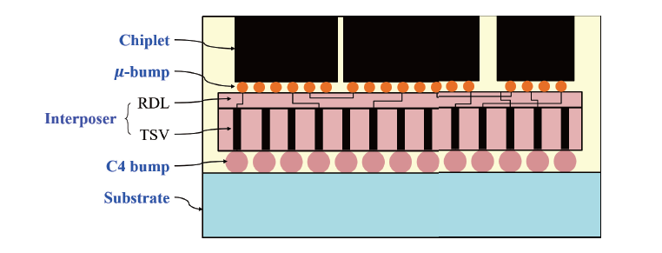
Introduction
2.5D ICs (or called interposer-based 3D IC) can provide better performance and yield than 2D ICs
Notes:
Interposer是chiplet以及substrate的interface
* μ-bump以及C4 bump是 Interposer與chiplet以及substrate的connections
* Chiplets間的nets是在Redistribution layer (RDL)間繞的

Slide 5
Introduction
Develop an efficient chiplet placer : SP-CP (Sequence-pair Chiplet placer)
Build the sequence pair based tree (SP-Tree), which contains the rotation and partial/complete SP representation.
Apply B&B method to get the optimal solution.
Apply advance placement/pruning techniques for faster runtime
Apply post placement procedure to reduce the operating temperatures but increase TWL slightly

Slide 6
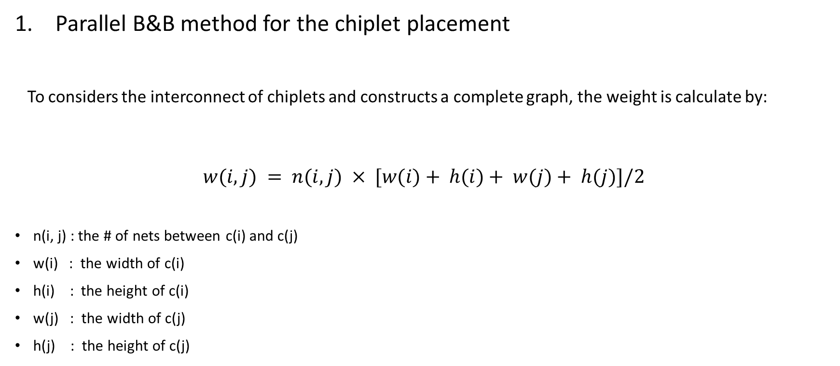
Preliminary
Parallel B&B method for the chiplet placement
To considers the interconnect of chiplets and constructs a complete graph, the weight is calculate by:
$$w(i, j) = n(i, j) × [w(i)+ h(i)+ w(j)+ h(j)]/2$$
n(i, j) : the # of nets between c(i) and c(j)
w(i) : the width of c(i)
h(i) : the height of c(i)
w(j) : the width of c(j)
h(j) : the height of c(j)
Notes:
這個公式可以決定哪一個node與sorted nodes有最多的Cut。

Slide 7
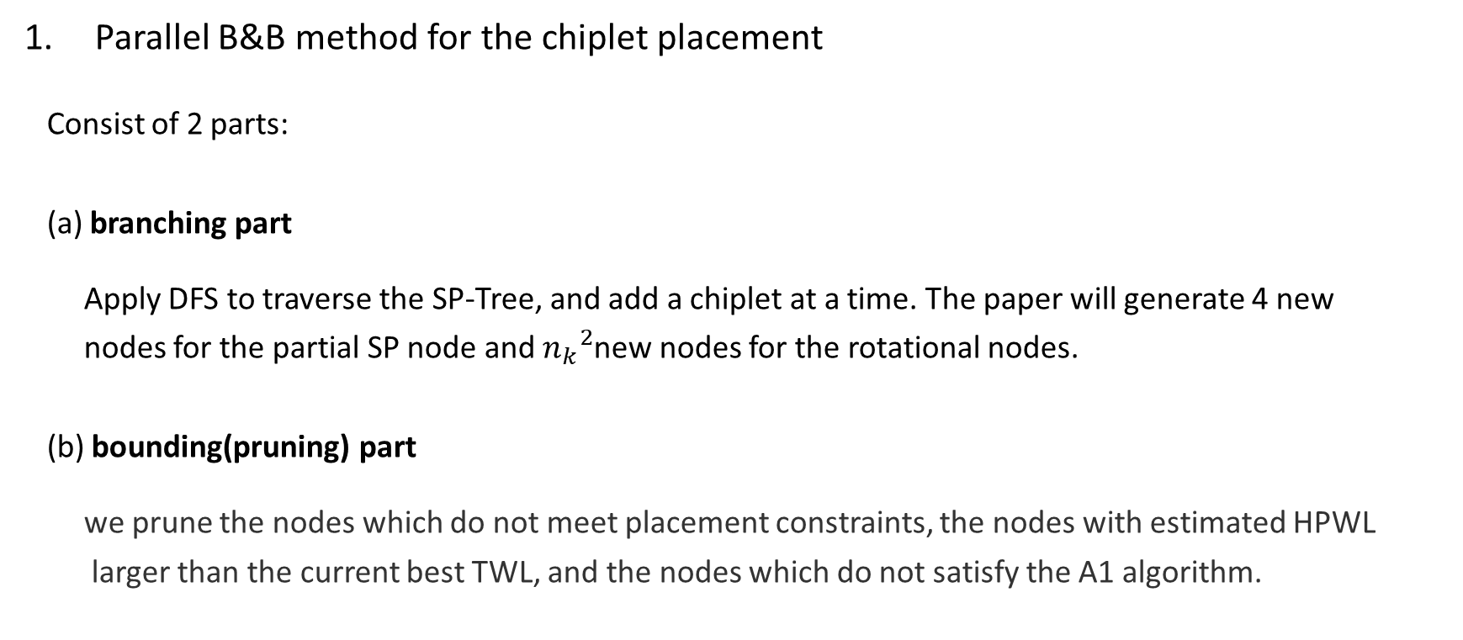
Preliminary
這篇paper使用OpenMP來對B&B algorithm進行平行處理，並且每當更新best TWL，他們就會暫停其他thread來更新值以確保效率。
Parallel B&B method for the chiplet placement
Consist of 2 parts:
(a) branching part
Apply DFS to traverse the SP-Tree, and add a chiplet at a time. The paper will generate 4 new
nodes for the partial SP node and ${n_{k}}^{2}$new nodes for the rotational nodes.
(b) bounding(pruning) part
we prune the nodes which do not meet placement constraints, the nodes with estimated HPWL
larger than the current best TWL, and the nodes which do not satisfy the A1 algorithm.

Slide 8
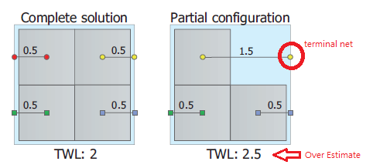
Preliminary
2. Placement optimization with whitespace
Notes:
在他比較的paper中，在進行placement optimization時，他們在擺放時會將cells放在interposer的左下角。這樣子如果chiplets有terminal nets時，Packing就不會是optimal。
TWL的overestimation可能造成低估找到optimal solution的機會

Slide 9
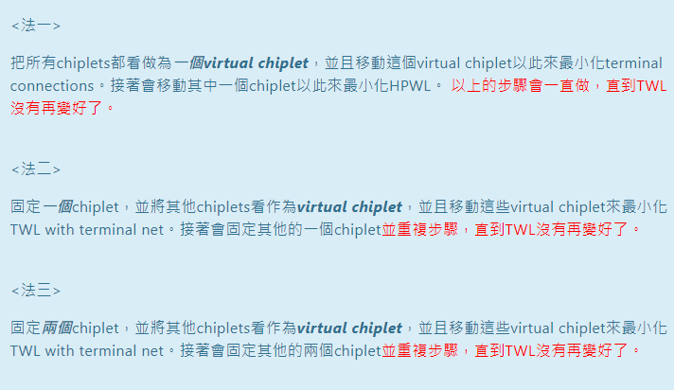
Preliminary
2. Placement optimization with whitespace

Slide 10
Preliminary
3. Terminal Handling (TH)
Minimal HPWL between die and related terminals
When a chiplet is added to a partial placement, we looks forward to predicting WL augmentation from its terminal nets (use the way of “placement optimization of whitespace”)
Total 4 TH values because of the rotation
Notes:
當一個chiplet被加入到partial placement，我們會想要從他的terminal nets來預測wirelength (WL)的augmentation (用剛剛"Placement Optimization with Whitespace"的方法)。
又因為每一個chiplet會有4個方向，所以共會有4個TH值。

Slide 11
Preliminary
4. Forward Wirelength Checking (FC)
minimal HPWL between two dies
calculates the minimum WL for each chiplet pair with the nets only connected between them (use the way of “placement optimization of whitespace”)
total 64 TH values because of the rotation + topology
Notes:
會對每兩個chiplet pair進行minimun wirelength的計算 (只計算那些只連到他們兩個的net)，最後會有4343種case (rotation中兩個chiplets共有4×4種可能，再加上兩個chiplets有4種topology的組合)

Slide 12
Preliminary
5. Sequence-pair Representation Methods
(… i … j … , … i … j …) → C(i) is on the left side of C(j)
(… j … i … , … j … i …) → C(i) is on the right side of C(j)
(… i … j … , … j … i …) → C(i) is under of C(j)
(… j … i … , … i … j …) → C(i) is above of C(j)
Notes:
(… i … j … , … i … j …) → C(i) 在 C(j)的左邊
(… j … i … , … j … i …) → C(i) 在 C(j)的右邊
(… i … j … , … j … i …) → C(i) 在 C(j)的下面
(… j … i … , … i … j …) → C(i) 在 C(j)的上面

Slide 13
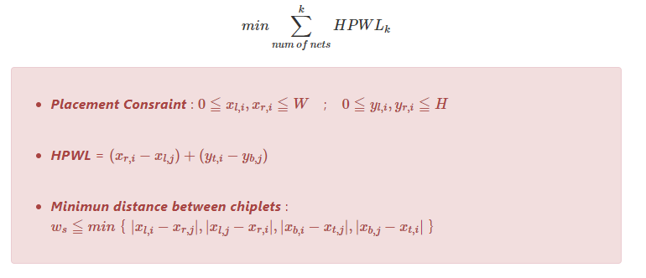
Problem formulation
1. Optimize HPWL
Notes:
一開始我們會先將「優化chiplet placement while minimizing TWL」公式化為:

Slide 14


Problem formulation
2. Optimize maximum temperature
We have found the optimal HPWL (${TWL}_{opt}$), and this step we the goal is to satisfy the thermal constraint $T_{cstr}$， and satisfy the constraint of $\frac{{TWL}_{mod}}{{TWL}_{OPT}}$ < η%
Notes:
如果在TWL限制內仍然無法達到Tcstr，則此Paper會選擇增加cost最小的placement (增加的TWL要< η%)，而Cost function 如下
TWL : 現在找到的wirelength
TWLmax : 在TWL增加量<η％ 的距離之間，所會得到的最大的TWL
TWLopt: 在optimize TWL中所得到的數值
Tmaxmin:在增加TWL<η％的距離之間，所有placement的可能最高溫度中的最高的溫度
Tmaxmax:在增加TWL<η％的距離之間，所有placement的可能最高溫度中的最低的溫度

Slide 15
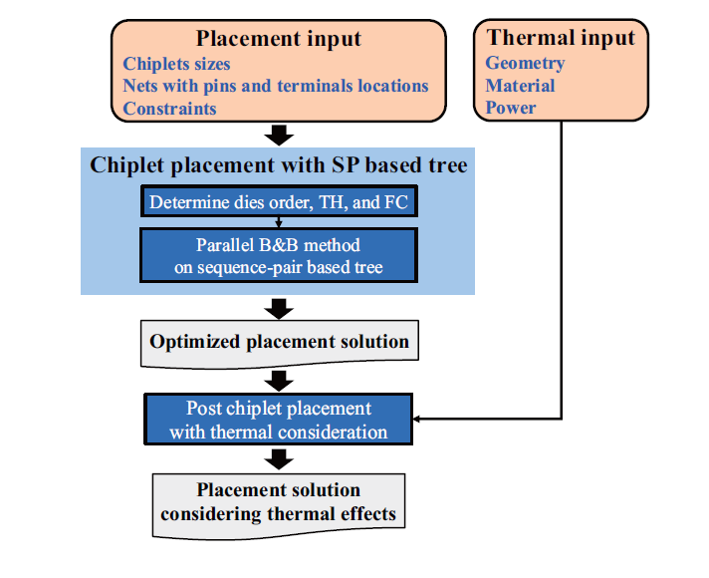
Chiplet placement with SP-based tree
Notes:
For placement input, ...
2. For Thermal input, …
3. Perform the placer preprocessing for die ordering and estimated HPWL (use the way of B&B Method)
4. Use parallel B&B method on sequence-pair based tree to get optimal and sub-optimal placement with minimizing HPWL
5. Perform post placement by considering the thermal effect to find near-optimal placement with lower Tmax

Slide 16
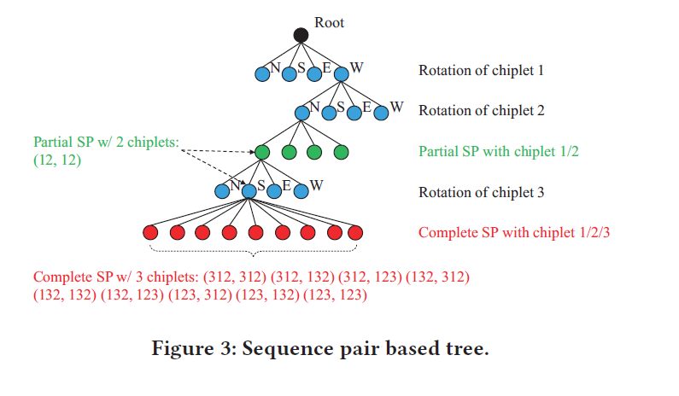
Chiplet placement with SP-based tree
Notes:
這篇paper主要是採取SP Tree的方法。
(i) rotation node with the direction of chiplet (北東南西，0、90、180、270) (藍色的點) (ii) partial SP for topological relation between chiplets (綠色的點) (iii) complete SP (紅色的點)
由圖我們可以發現，當我們將chiplet 3插入(12, 12)這個parent node，我們就可以得到9個complete SP (兩個座標各有3個位置可以插入: 3x3=9)

Slide 17
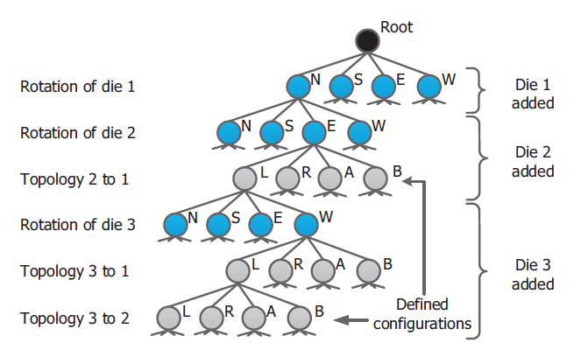
Chiplet placement with SP-based tree

Slide 18
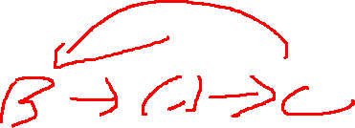
Chiplet placement with SP-based tree
Some of topology nodes in CSP-Tree might not be packed into a placement.
E.g.
(a) chiplet B (𝑐𝐵) is at the left of chiplet A (𝑐𝐴)
(b) chiplet C (𝑐𝐶) is at the right of chiplet A (𝑐𝐴)
(c) chiplet C (C𝑐) is at the left of chiplet B (𝑐𝐵)
-> form a cyclic horizontal constraint graph
Notes:
CSP-Tree 可能沒有辦法將一些topology node給pack起來

Slide 19
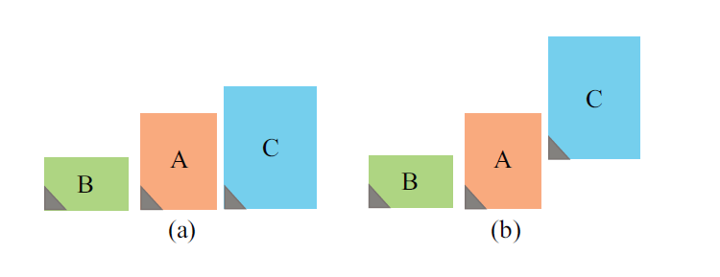
Chiplet placement with SP-based tree
2. one SP representation might cover multiple topology nodes in CSP-Tree
Notes:
如上圖，(a)中C block是在A block的右邊，而在(b)中C block是在A block的上面，但是他們兩個個都可以表示為 SP(BAC, BAC)

Slide 20
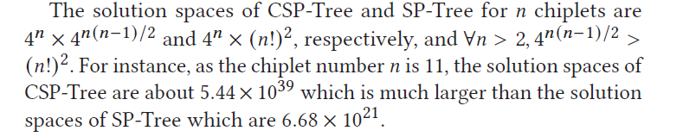
Chiplet placement with SP-based tree
3. CSP-Tree has higher complexity
Notes:
如上圖，(a)中C block是在A block的右邊，而在(b)中C block是在A block的上面，但是他們兩個個都可以表示為 SP(BAC, BAC)

Slide 21
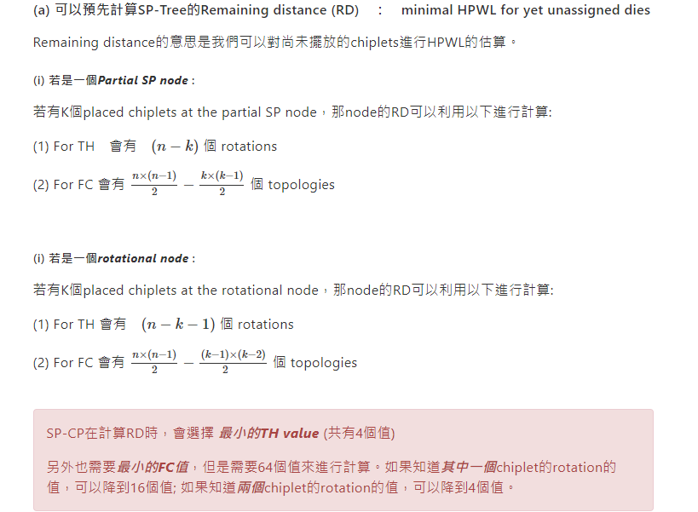

Slide 22
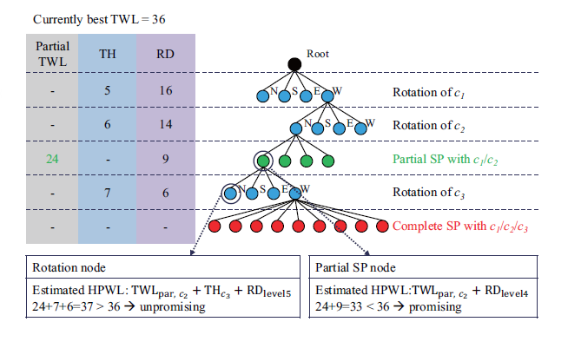
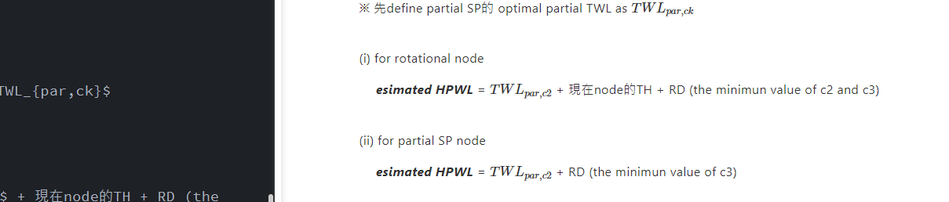
Advanced placement/pruning techniques
Notes:
※ 先define partial SP的 optimal partial TWL as TWLpar,ck
Remaining distance

Slide 23
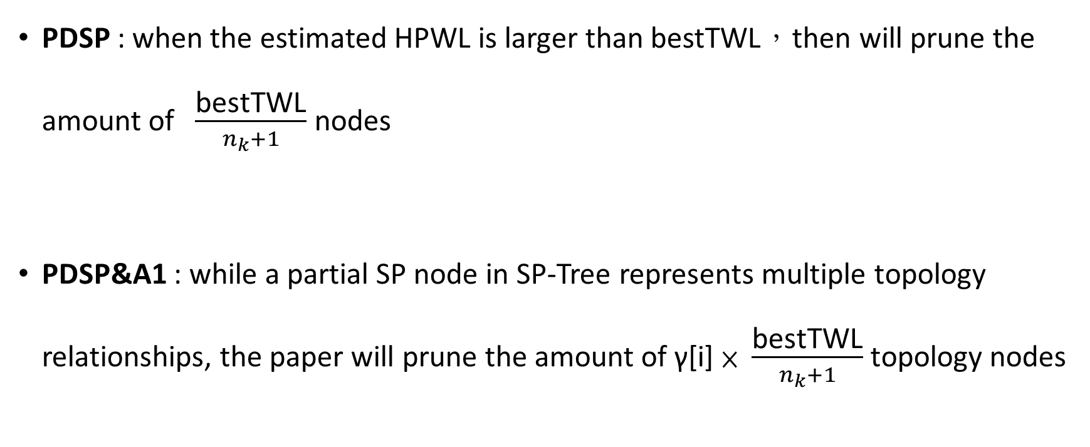
Advanced placement/pruning techniques
PDSP : when the estimated HPWL is larger than bestTWL，then will prune the amount of $\frac{\text{bestTWL}}{n_{k}+1}$ nodes
PDSP&A1 : while a partial SP node in SP-Tree represents multiple topology relationships, the paper will prune the amount of γ[i] × $\frac{\text{bestTWL}}{n_{k}+1}$ topology nodes
Notes:
1 . PDSP是計算它的hpwl是否超過大於現在最好的TWL (bestTWL)，是的話可以prune掉以降低運算時間
2.

Slide 24
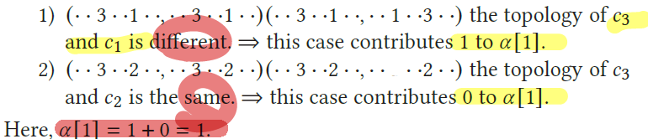
Advanced placement/pruning techniques
E.g.
We inserting C3 into partial SP (12, 12), and we assume (312, 312) have the minimum estimated HPWL at the same level. we compare the topology of C3 with C1, and the topology of C3with C2:
Notes:
inserting c3 into partial SP (12, 12), we analyze the contribution to α[i]. Here, we assume (312, 312) have the minimum estimated HPWL at the same level. For (312, 312) and (312, 132) at node 1 at the same
level, we compare the topology of c3 with c1, and the topology of c3with c2.

Slide 25
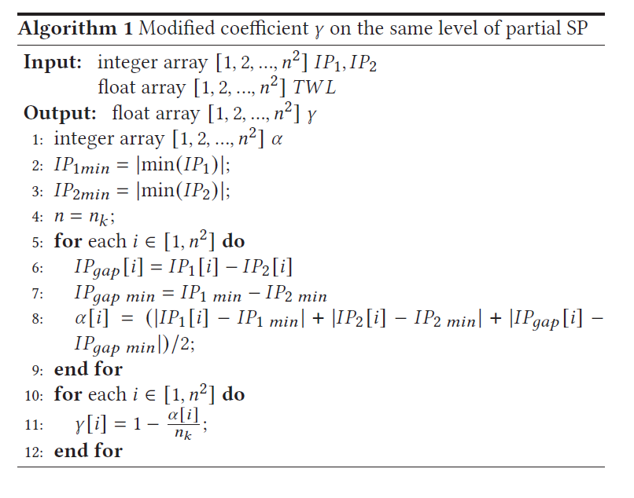
Advanced placement/pruning techniques
Notes:
we define α[i] to be the number of topology differences between the partial SP at node & and the partial SP having the best estimated HPWL at the same level.
We record the positions of the chiplet inserted by two sequences. insertion position1 (IP1) and insertion position 2 (IP2), and record the gap between the insertion positions of these two sequences (IPgap).
我猜IP1是指想看的那個sequence，IP2是最好的那個matrix，然後n^2是因為要插入的chiplet可以有n*n種選擇方式

Slide 26

Post Chiplet placement (post-cp) with thermal consideration
1. Chip thermal simulation:
$$GT=P$$
G : thermal conductance matrix
T : thermal vector
P : power source vector

Slide 27
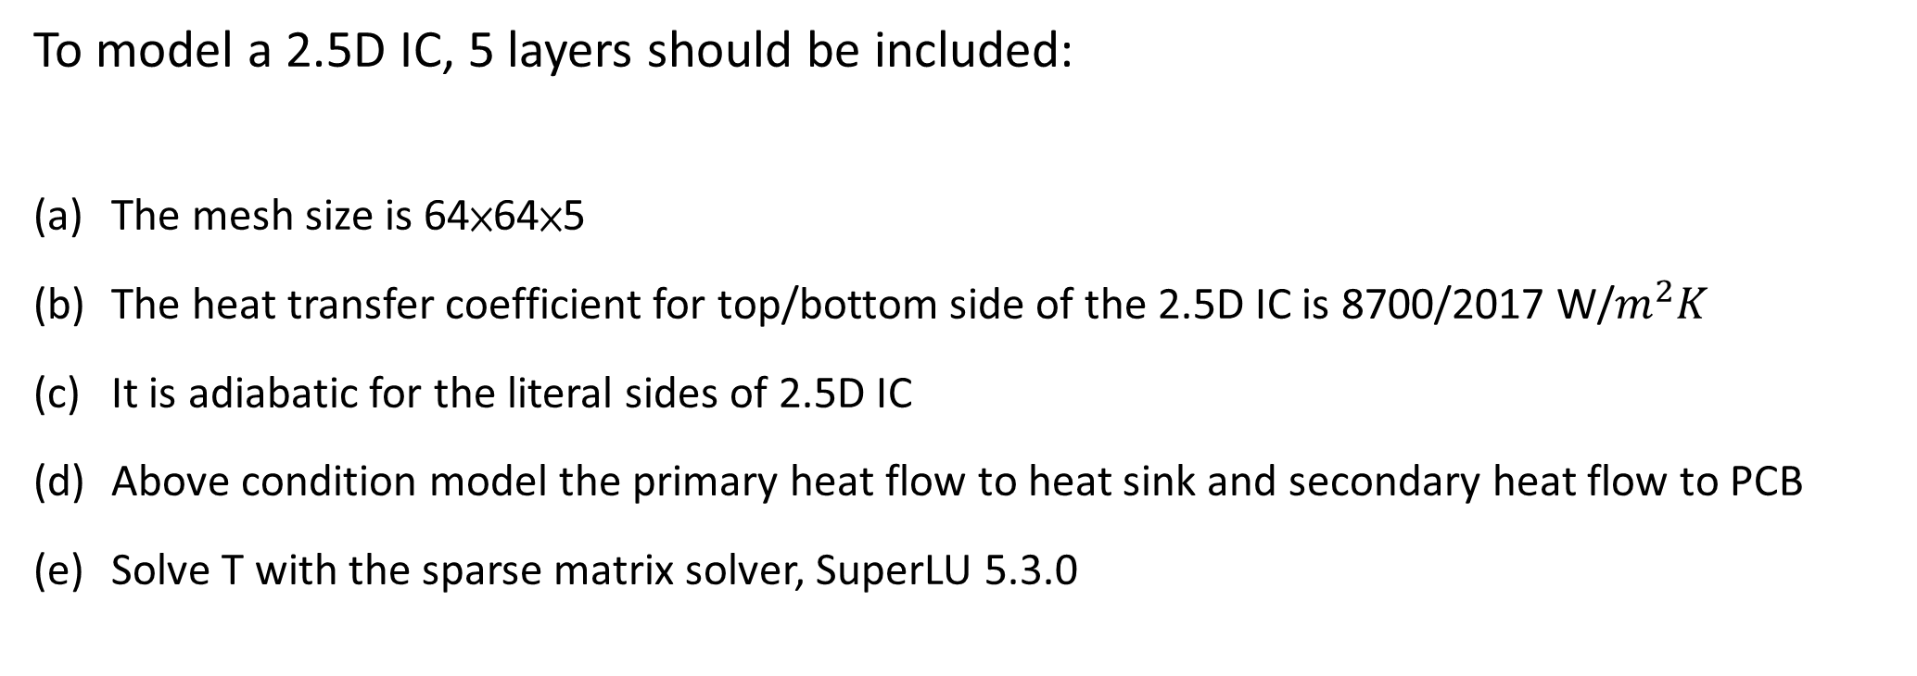
Post Chiplet placement (post-cp) with thermal consideration
To model a 2.5D IC, 5 layers should be included:
The mesh size is 64×64×5
The heat transfer coefficient for top/bottom side of the 2.5D IC is 8700/2017 W/$m^{2}K$
It is adiabatic for the literal sides of 2.5D IC
Above condition model the primary heat flow to heat sink and secondary heat flow to PCB
Solve T with the sparse matrix solver, SuperLU 5.3.0
Notes:
要model一個2.5D IC的heat transfer，那五層都要include到，因此需要用到以下的特性:
留言
(a) mesh的size為64* 64 *5
(b) 頂部的熱傳導係數為，底部的熱傳導係數為2017 ，主要是用來模擬熱量從chiplet流向散熱器以及PCB的主要以及次要的heat flow
© 針對2.5D IC的lateral side(側邊) ，他會是絕熱(adiabatic)的
接著他們會利用 matrix solver, SuperLU 5.3.0，來求解T。 最後的實驗結果顯示，跟commercial tool Icepak相比，最大的溫度誤差<1%，又由於Icepak所需的時間較長，所以他們採取這種方式。

Slide 28
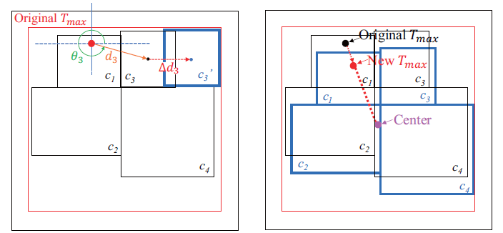
Post Chiplet placement (post-cp) with thermal consideration
2. Placement refinement with thermal effects
↑ Move one chiplet at a time
↑ Move all chiplet toward the center
Notes:
第二個要保持他們的relative positions

Slide 29
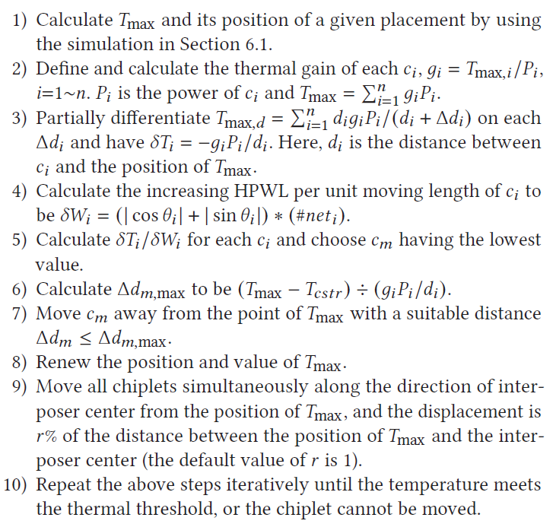
Post Chiplet placement (post-cp) with thermal consideration
Notes:
一開始我們會有一個會違反thermal constraint 的Placement result，以及Tmax的value以及位置:
計算每一個chiplets ci對於Tmax的貢獻 (用superposition)
計算每一個chiplets $c_{i} 移動特定距離 (Δ di)所會造成的wirelength increase
假設兩個chiplets中互相影響的溫度效應是正比於$\frac {1} {distance} $
接著就會計算移動每一個chiplets的效率 = δTi/δWi
(temperature variation / increased wirelength per unit moving length) (值愈低愈好)

Slide 30
Post Chiplet placement (post-cp) with thermal consideration
Notes:
在找到最適合移動的chiplet Cm，並且找到最適合的移動距離，以此來讓他符合constraints。
留言
最後在移動chiplet後，Paper會更新Tmax的值以及位置。最後，為增加散熱面積，paper會使用方法二來一次移動所有的chiplets to the center(移動距離default是Tmax的點到interposer的中心的1%)。
最後的停止條件為:
(1) Tmax 小於treshold了
(2) chiplets已經沒有辦法再移動了(遇到boundary或是其他的chiplets)

Slide 31
Experimental results
C++ language with compiler gcc 8.3.1
Execute on linux workstation
CPU : Intex Xeon E5-2620 v4 with 8 cores at 2.10 GHz
Benchmarks:
(1) Interposer-based chiplets case with 4, 6, 8 chiplets (t4/t6/t8)
(2) MCNC benchmarks with 9, 10, 11 chiplets (apte/xeron/hp)
(3) Modified MCNC benchmarks for practical 2.5D IC within
whitespace from 5%~20%

Slide 32
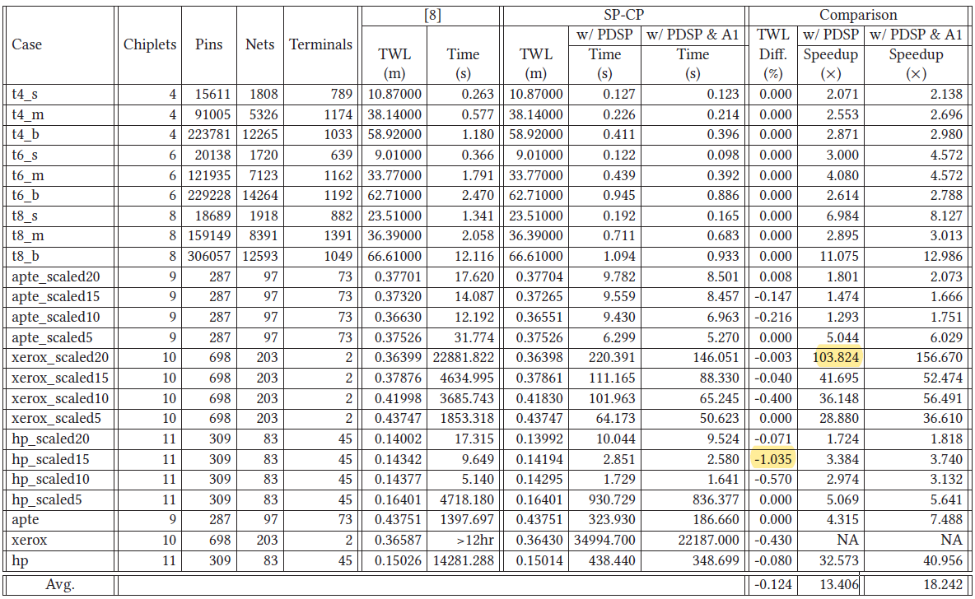

Experimental results

Slide 33
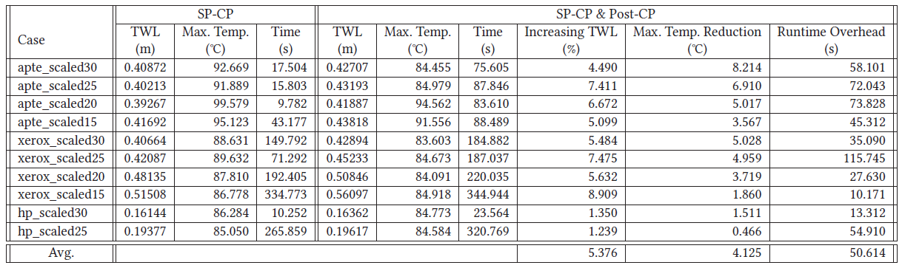




Experimental results
$w_{space}= 0.1 mm$ $T_{cstr }=85℃$
$$η = 10$$
$Φ$ = 0.5

Slide 34
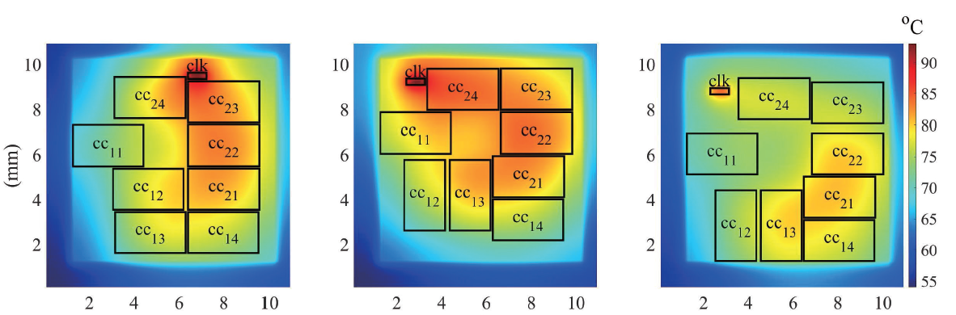
Experimental results

Slide 35
Thank you for listening

